Slide 1
Health Equity Network of the Americas
Governance Committee Meeting
May 16, 2018
Michael A. Rodriguez, MD, MPH
Founding Director, UCLA Blum Center on Poverty and Health in Latin America
Founding Chair, Health Equity Network of the Americas
Professor of Medicine, Geffen School of Medicine at UCLA
Rocio Saenz, MD, MPH, PhD
Professor of Master of Epidemiology, National University, Costa Rica
Co-Chair, Governance Committee, Health Equity Network of the Americas

Slide 2

Notes:
As a reminder please:
To request the floor- Press the hand icon to the left hand sidebar
Once you request the floor, Andrea (the moderator) will receive a notification that someone has requested the floor.
Andrea (the moderator) will be able to see the order in which people have requested to speak.
In between people speaking, Andrea (the moderator) will announce who is speaking next to prepare the speaker that they will speak and pass the baton.
If you need help, press the question mark at the bottom left hand sidebar and someone from Voiceboxer will be able to help you.

Slide 3
Agenda Items
1. Governance Committee– Overview
2. Advocacy and Communications Committee – Overview, naming, and new leaders
3. Priority areas for the Governance Committee
4. Opportunities for engagement

Slide 4
ROAD MAP
Where we’ve been, where we are, and where we’re going
Organizational Structure, Leadership Patterns, and Systems Design
Membership Definition, Criteria and Terms
Policies and Procedures
Strategic Plan
Plan for Ongoing Evaluation of Network Performance and Progress Towards Goals and Objectives
Identified Governance Priority Areas
Notes:
We’ve identified priority areas that we’ll be working on as a committee.
Read list.

Slide 5
ROAD MAP
Where we’ve been, where we are, and where we’re going
Organizational Structure, Leadership Patterns, and Systems Design
✓ Membership Definition, Criteria and Terms
✓ Communication Platform
✓ Caribbean Integration
Policies and Procedures
Strategic Plan
✓ General Objective
✓ Vision, Mission, Goals
Plan for Ongoing Evaluation of Network Performance and Progress Towards Goals and Objectives
Identified Governance Priority Areas
Notes:
If you look at the agenda, we’ll be finishing up the discussion on membership definition, criteria and terms by going over any feedback committee members submitted on the Membership Guideline.

Slide 6
ROAD MAP
Where we’ve been, where we are, and where we’re going
Organizational Structure, Leadership Patterns, and Systems Design
✓ Membership Definition, Criteria and Terms
✓ Communication Platform
✓ Caribbean Integration
Policies and Procedures
Strategic Plan
✓ General Objective
✓ Vision, Mission, Goals
Plan for Ongoing Evaluation of Network Performance and Progress Towards Goals and Objectives
Identified Governance Priority Areas
Notes:
Today’s meeting we’re going to move onto our next priority area which consists of organizational structure, leadership patterns and systems design. We will get more in detail about it in the next slide.

Slide 7
REPORTS

Slide 8
THE HEALTH EQUITY NETWORK OF THE AMERICAS (HENA)
GOVERNANCE COMMITTEE CHARTER
What’s New?

Slide 9
THE HEALTH EQUITY NETWORK OF THE AMERICAS (HENA)
GOVERNANCE COMMITTEE CHARTER
Structure of the document
What’s New?

Slide 10
THE HEALTH EQUITY NETWORK OF THE AMERICAS (HENA)
GOVERNANCE COMMITTEE CHARTER
Structure of the document
What’s New?
Leadership Roles & Support
Notes:
Structure: Formatted it to reflect a more official document; Added sections

Slide 11
THE HEALTH EQUITY NETWORK OF THE AMERICAS (HENA)
GOVERNANCE COMMITTEE CHARTER
Structure of the document
What’s New?
Leadership Roles & Support
Director
Co-Chair
Committee Members
Internal Staff
Notes:
Structure: Formatted it to reflect a more official document; Added sections

Slide 12
THE HEALTH EQUITY NETWORK OF THE AMERICAS (HENA)
GOVERNANCE COMMITTEE CHARTER
Structure of the document
Leadership & Support Descriptions
What’s New?
Leadership Roles & Support
Director
Co-Chair
Committee Members
Internal Staff
Notes:
Structure: Formatted it to reflect a more official document; Added sections

Slide 13
THE HEALTH EQUITY NETWORK OF THE AMERICAS (HENA)
GOVERNANCE COMMITTEE CHARTER
Structure of the document
Leadership & Support Descriptions
What’s New?
Leadership Roles & Support
Leadership & Support Responsibilities
Director
Preparation for Meetings
Co-Chair
During Meetings
Committee Members
Internal Staff
Notes:
Structure: Formatted it to reflect a more official document; Added sections

Slide 14
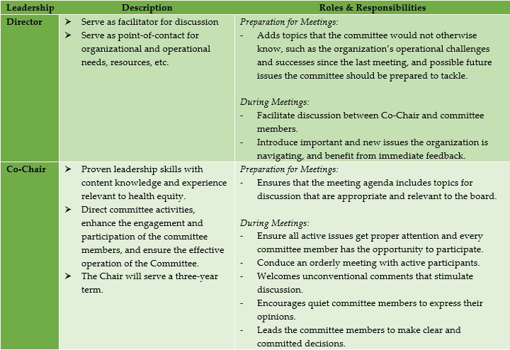
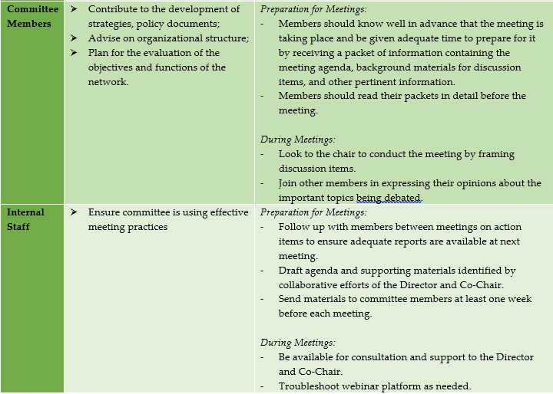
THE HEALTH EQUITY NETWORK OF THE AMERICAS (HENA)
GOVERNANCE COMMITTEE CHARTER
Added- Roles and Responsibilities
REVIEW AND PROVIDE SUGGESTIONS
Notes:
Not to discuss, but for reference so they know how it looks like.

Slide 15
Questions, Comments, Suggestions?

Slide 16
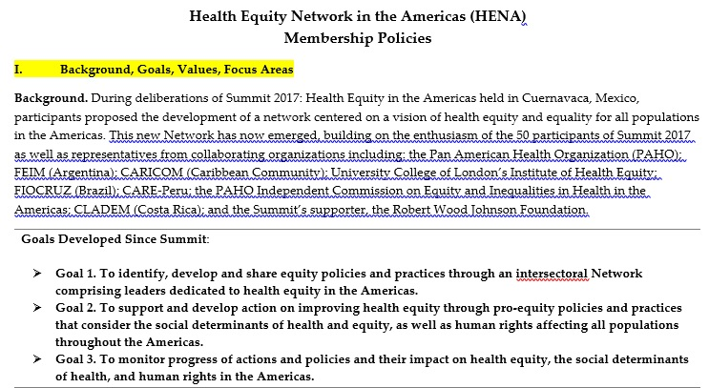
THE HEALTH EQUITY NETWORK OF THE AMERICAS (HENA)
MEMBERSHIP GUIDELINES
Background, Goals, Values, Focus Areas (page 1)
- As suggested by committee members
What’s New?

Slide 17
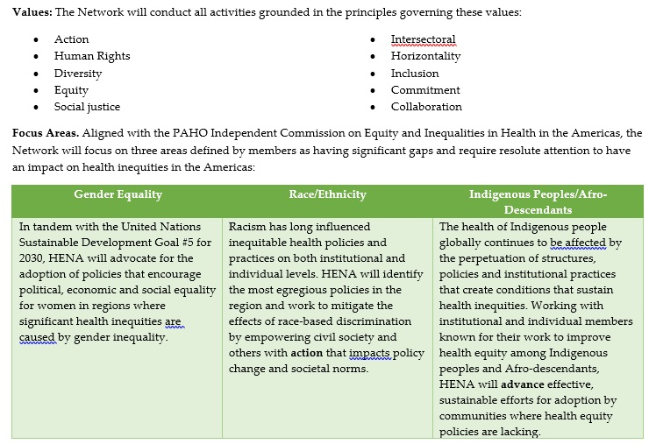
THE HEALTH EQUITY NETWORK OF THE AMERICAS (HENA)
MEMBERSHIP GUIDELINES
Background, Goals, Values, Focus Areas (page 1)
- As suggested by committee members
What’s New?

Slide 18
THE HEALTH EQUITY NETWORK OF THE AMERICAS (HENA)
MEMBERSHIP GUIDELINES
Background, Goals, Values, Focus Areas (page 1)
- As suggested by committee members
What’s New?
Language: More inclusive and engaging (page 2- highlighted)
- As suggested by committee members

Slide 19
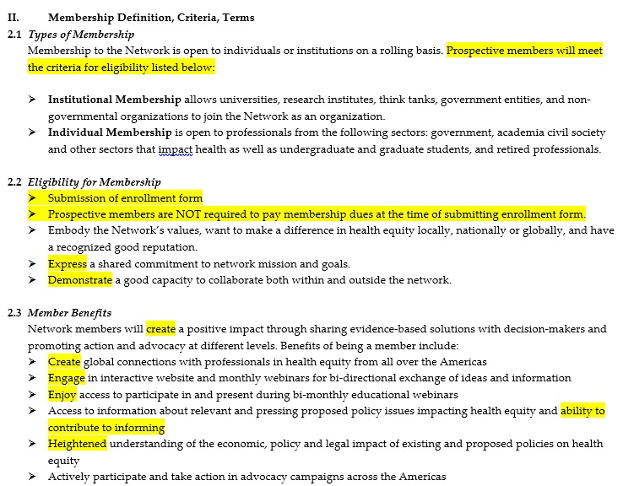
THE HEALTH EQUITY NETWORK OF THE AMERICAS (HENA)
MEMBERSHIP GUIDELINES
Language: More inclusive and engaging (page 2- highlighted)
- As suggested by committee members
What’s New?

Slide 20
Questions, Comments, Suggestions?

Slide 21
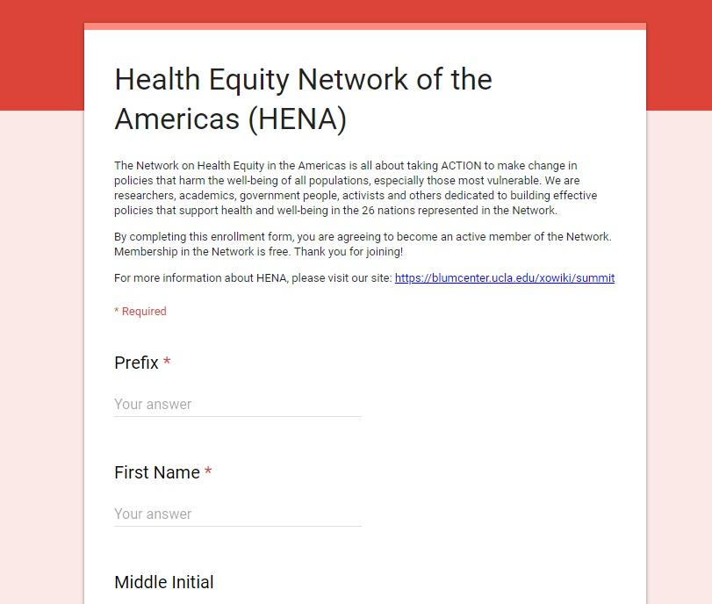
ENROLLMENT FORM
English: https://goo.gl/forms/z8IzpvbVh2edE5hB3
Spanish: https://goo.gl/forms/PuVzOOk1fPfDe8Mi1
Notes:
We have sent an engagement email with the enrollment form. We will provide you a link after the meeting if you want to invite others to join.

Slide 22
PROGRESS 1

Slide 23
THE HEALTH EQUITY NETWORK OF THE AMERICAS (HENA)
ADVOCACY AND COMMUNICATIONS COMMITTEE
Committee Organization
What’s New?

Slide 24



THE HEALTH EQUITY NETWORK OF THE AMERICAS (HENA)
ADVOCACY AND COMMUNICATIONS COMMITTEE
Committee Organization
What’s New?

Slide 25


THE HEALTH EQUITY NETWORK OF THE AMERICAS (HENA)
ADVOCACY AND COMMUNICATIONS COMMITTEE
Committee Organization
Eugenia Tarzabachi
What’s New?

Slide 26

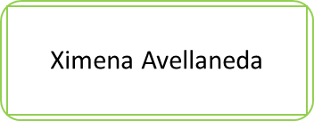

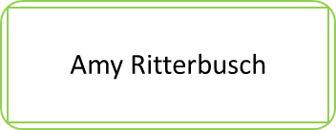
THE HEALTH EQUITY NETWORK OF THE AMERICAS (HENA)
ADVOCACY AND COMMUNICATIONS COMMITTEE
Committee Organization
Eugenia Tarzabachi
What’s New?
Notes:
Insert Pictures

Slide 27
ACTION ITEMS

Slide 28
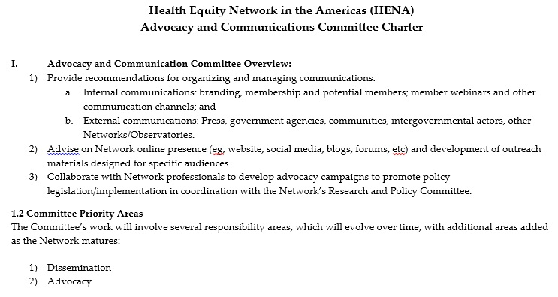
THE HEALTH EQUITY NETWORK OF THE AMERICAS (HENA)
ADVOCACY AND COMMUNICATIONS CHARTER
Supporting Materials

Slide 29
Review Advocacy and Communications Charter
ACTION ITEMS
Provide feedback by Wed. 5/30

Slide 30
PROGRESS 2

Slide 31
GOVERNANCE PRIORITY AREAS
Organizational Structure: Define the Network’s characteristics, division of labor, decision-making, rules, procedures, culture, rights/obligations, privileges/responsibilities, values, norms, people, structure, objectives, goals, and mission statement.
Organizational Structure, Leadership Patterns, and Systems Design
Membership Definition, Criteria and Terms
Policies and Procedures
Strategic Plan
Plan for Ongoing Evaluation of Network Performance and Progress Towards Goals and Objectives
Leadership Patterns: Behavioral patterns that a leader adopt to influence the behavior of its’ committee members.
Systems Design: Systemic approach to the design of a system (bottom-up vs. top-down approach) wherein it takes into account all related variables of the system that needs to be created.

Slide 32
GOVERNANCE PRIORITY AREAS
Objectives:
Understand the main features of the Network and setting objectives in guiding the Network.
Determine how the roles and responsibilities are assigned, controlled, and coordinated by designing job descriptions, to whom members should report to, and how information flows between all committees and the entire Network.
Determine decision-making and ensure it is distributed between members.
As the organization expands, include additional layers of management, new committees, expanding one or several functional areas or appointing additional co-chairs.
Organizational Structure

Slide 33
GOVERNANCE PRIORITY AREAS
Objectives:
Understand the main features of the Network and setting objectives in guiding the Network.
Determine how the roles and responsibilities are assigned, controlled, and coordinated by designing job descriptions, to whom members should report to, and how information flows between all committees and the entire Network.
Determine decision-making and ensure it is distributed between members.
As the organization expands, include additional layers of management, new committees, expanding one or several functional areas or appointing additional co-chairs.
Organizational Structure
FINANCE & DEVELOPMENT COMMITTEE

Slide 34
GOVERNANCE PRIORITY AREAS
Objectives:
Understand the main features of the Network and setting objectives in guiding the Network.
Determine how the roles and responsibilities are assigned, controlled, and coordinated by designing job descriptions, to whom members should report to, and how information flows between all committees and the entire Network.
Determine decision-making and ensure it is distributed between members.
As the organization expands, include additional layers of management, new committees, expanding one or several functional areas or appointing additional co-chairs.
Organizational Structure
RESEARCH & POLICY COMMITTEE

Slide 35
ORGANIZATIONAL STRUCTURE:
New Committee
1) Who do we want to be part of each Committee?
FINANCE & DEVELOPMENT
Securing and management of financial resources
Development of a financial sustainability plan
RESEARCH & POLICY
Support for PAHO Commission
Planning, implementation and evaluation

Slide 36
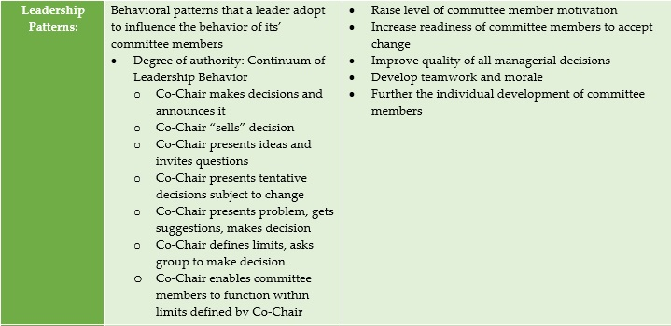
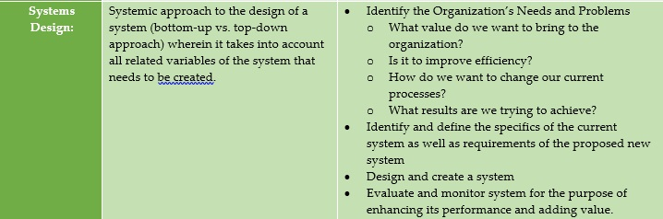
THE HEALTH EQUITY NETWORK OF THE AMERICAS (HENA)
GOVERNANCE COMMITTEE PRIORITY AREA:
Organizational Structure, Leadership Patterns, and Systems Design
Supporting Materials
Reference

Slide 37
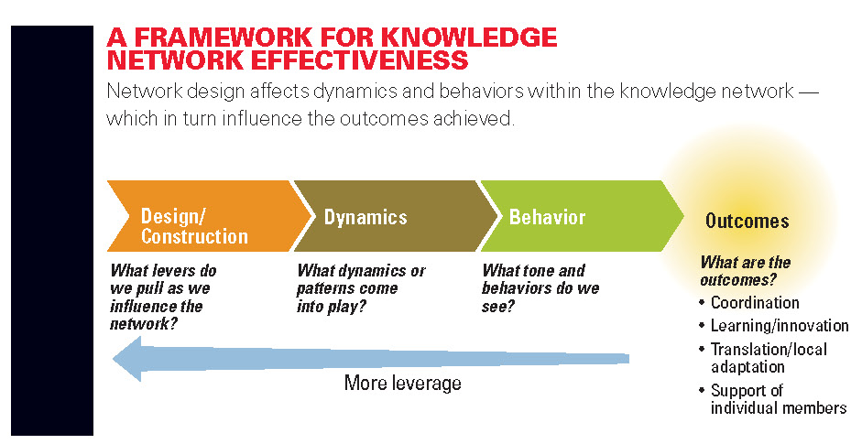
THE HEALTH EQUITY NETWORK OF THE AMERICAS (HENA)
GOVERNANCE COMMITTEE PRIORITY AREA:
Organizational Structure, Leadership Patterns, and Systems Design
Supporting Materials
“Designing Effective Knowledge Networks”
Evidence-based models for network development and systems design
Source: Pugh K, Prusak K. Designing Effective Knowledge Networks. MIT Sloan Management Review. 2013;66(1).

Slide 38
Review Governance Committee Priority Area: Organizational Structure, Leadership Patterns, and Systems Design
ACTION ITEMS
Identify 2 objectives and/or make suggestions for each sub-group by Wed. 5/30

Slide 39
THANK YOU!
Send information and feedback by Wednesday, May 30:
HealthEquidadNetwork@mednet.ucla.edu
NEXT MEETING: JUNE 13, 2018 @ 9:00am PT
Continue discussion on Governance Priority Areas
!

